Slide 1
WP5, Case Study 3
Title CS: Extreme weather risks to maritime activities
Lead: Øivin Aarnes (DNV GL), Martin King (NORCE) Contributors: Olga Shipilova (DNV GL), Morten Mejlænder-Larsen (DNV GL)
Notes:
With the backdrop of this image, I would like to start with mentioning a couple of incidents during the last year, just to cast light to the relevance of the case study.
frozen in ice - Norwegian explorer vessel Lance on rescue mission before Christmas 2019. navigation in ice, under rather unconventional conditions
Norwegian trawler Northguider caught in a storm and stranded on the North shores of Svalbard in the Hinlopen strait due to exceptionally strong winds and impaired manoeuvrability (due to trawling)
Viking Sky cruise vessel near fatal accident of near Hustadvika of the West coast of Norway March 23 last year - ship was caught in storm, and engines stopped

Slide 2
Overall Implementation
Good progress since summer 2019. We are reaching common ground.
CS is developing within budgets and constraints
More dissemination and outreach scheduled for 2021.
Climate service to be delivered in the shape of an interactive web mapping application.
Notes:
constraint: delay due to COVID-19, expecting CS implementation to extend into spring 2021.
key impacts are improved co-design with other work packages, consensus on objectives and recognition with stakeholders.
science on MCAOs is developing into possible predictors.
there's a need for continued research on processes and links, even integrating stratospheric events, for these to evolve into skilful predictions.

Slide 3
Impacts Achieved
Improve the capacity to respond to the impact of climatic change on the environment and human activities in the Arctic
Understanding how [extreme weather] events develop helps the industry attain risk awareness; mitigate impact and conduct more sustainable operations.
Improve stakeholders’ capacity to adapt to climate change
Ocean-based industries are increasingly integrating climate risks into their long term business strategies.
Notes:
Understanding how [extreme weather] events develop helps the industry improve risk awareness; issue emergency prevention plans and mitigate environmental and human impact.
Ocean-based industries are increasingly integrating climate risks into their long term business strategies. Reporting and disclosure of climate risks (physical, financial, transitional risks) helps drive sustainable financing.

Slide 4
Expected future impacts
Attention towards severe marine weather events (incl. polar lows) among ocean-based industries.
Awareness and adaptation towards climate resilience in coastal communities.
Ports and essential coastal infrastructure adapt to sustain extreme events.
More coherent and science-based decision making among industry players.
Contributions to EU Arctic policy development and regulation, and alignment with targets of UN SDGs 9, 13 and 14.
Protecting, preserving, and restoring Arctic natural ecosystems, to the sustainable use of ocean resources.
Notes:
ensure ports and essential coastal infrastructure are being adapted to ensure proper resilience to extreme events (especially in small islands and developing states).
ensure ports and coastal infrastructure worldwide are ready, resilient and able to minimize the impacts of extreme events on communities, businesses and economies.

Slide 5
Identified gaps to achieve desired impact
Blue Action has identified a means of describing MCAOs through the MCAO index. The index has been assessed in terms of predictive skill and lead time.
Although the index serves as a precursor, the link between an MCAO event and actual surfacing of a polar low is not entirely understood, yet quantified.
To achieve a coherent view, other indicators (atmospheric and ocean features) need to be included.
In order to integrate severe weather forecasts into risk maps (the climate service), a model for providing forecasts of MCAOs need to be operational.
What are likely implications of processes such as Weakening of the AMOC, Arctic amplification, and Thermal instability in lower layers?
Can we relate these processes to more storminess in the North seas, and what are the repercussions?
Notes:
Science:
Continued efforts needed to understand the nature of MCAOs
Predicting MCAOs in relation to indicators identified
Forecasting of polar lows with respect to indicators identified (MCAO index, potential temperature, sea ice coverage)
Possible inclusion of links to stratospheric events such as sudden stratospheric warming and polar vortex anomalies
What are likely implications of processes such as Weakening of the AMOC, Arctic amplification, and Thermal instability in lower layers?
Can we relate these processes to a more unstable atmosphere in the North seas, and what are the repercussions?

Slide 6
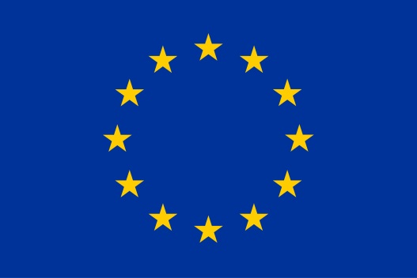
Thank you!
The Blue-Action project has received funding from the European Union’s Horizon 2020 research and innovation programme under grant agreement No 727852
Twitter: @BG10Blueaction
Zenodo: https://www.zenodo.org/communities/blue-actionh2020
www.blue-action.eu

