Slide 1
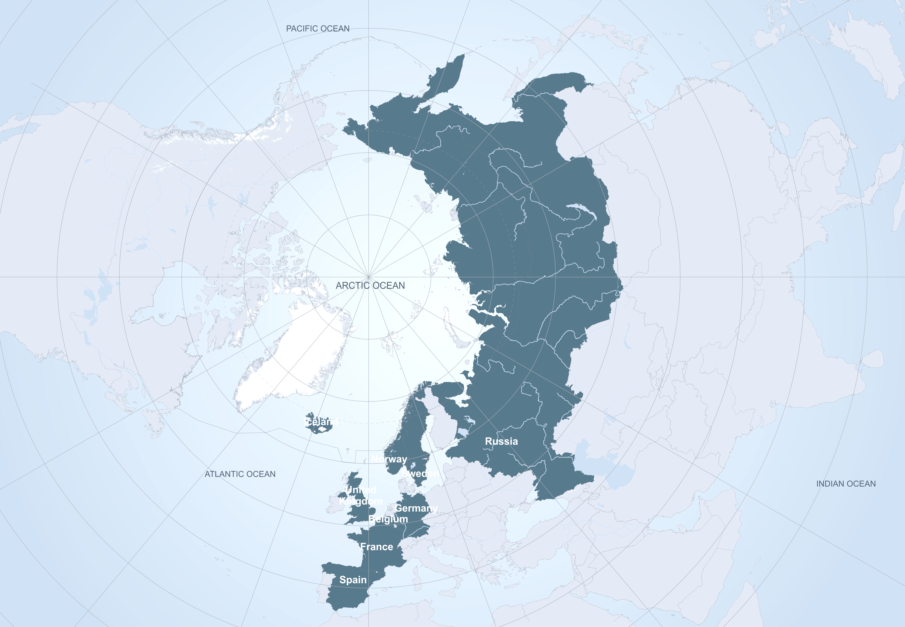


APPLICATE
Advanced Prediction in Polar regions and beyond: Modelling, observing system design, and LInkages associated with a Changing Arctic ClimATE
Thomas Jung (coordinator)
Alfred Wegener Institute (AWI), Germany
APPLICATE project has received funding from the European Union´s Horizon 2020 research and innovation programme under grant agreement No 727862.
The content of the document is the sole responsibility of the organizer and it does not represent the opinion of the European Commission and the Commission is not responsible for any use that might be made of the information contained.
www.applicate.eu

Slide 2


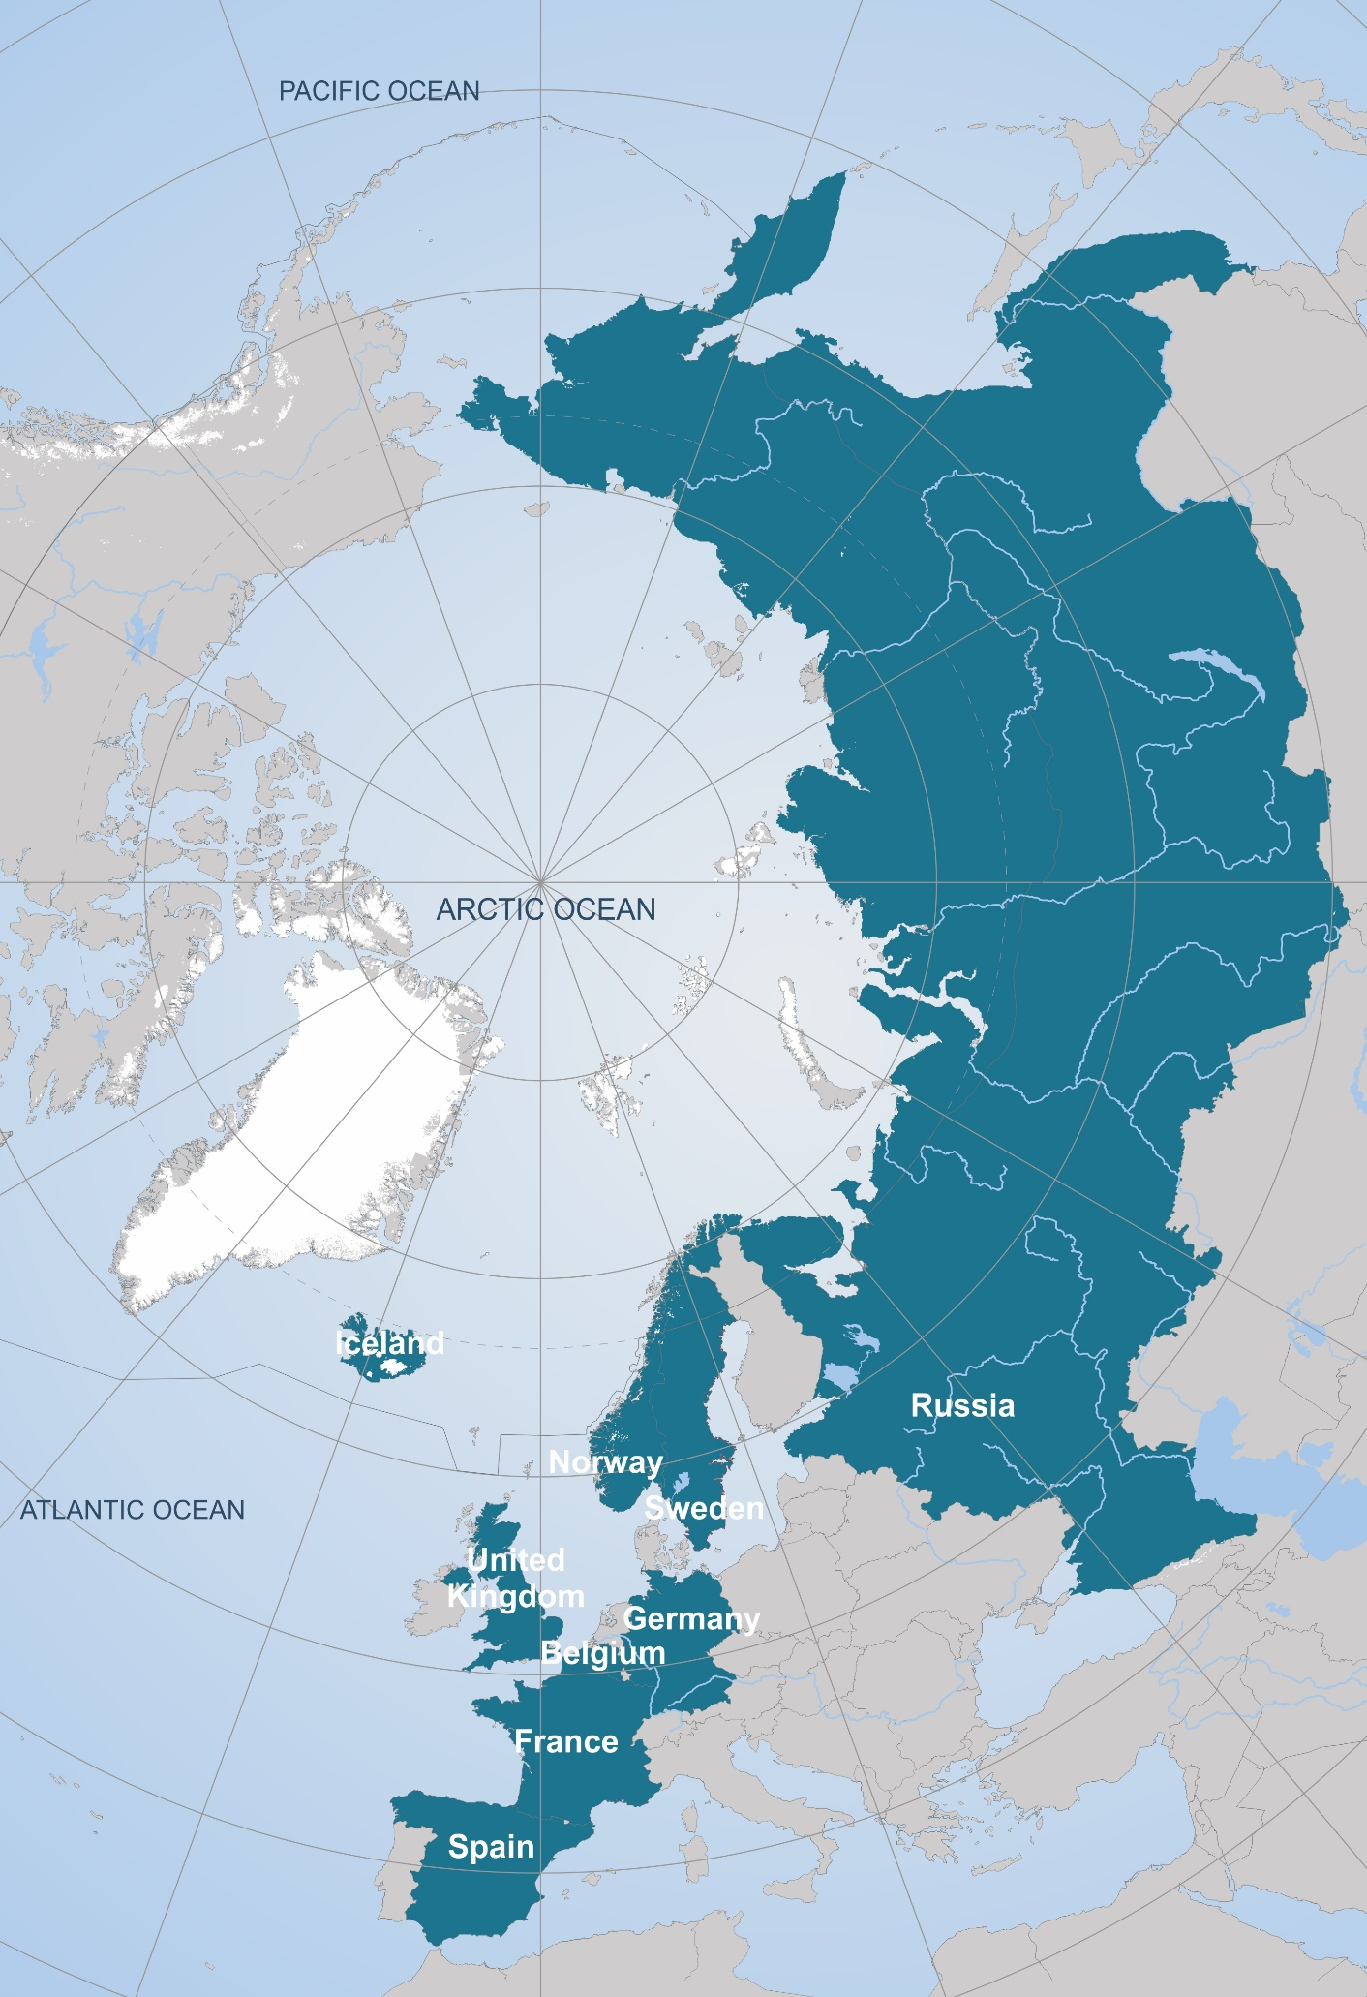















16 partners from nine countries
...and many international collaborators

Slide 3
Budget and duration
Budget: € 8 Mio + separate Russian contribution
1st November 2016–31st October 2020 (4-years)

Slide 4
Mission statement
Develop enhanced predictive capacity for weather and climate in the Arctic and beyond, and determine the influence of Arctic climate change on Northern Hemisphere mid-latitudes, for the benefit of policy makers, businesses and society.

Slide 5
General approach
Bring together the NWP and climate communities
Involve experts on the Arctic and midlatitudes
Engage operational centres for maximizing impact
Effectively combine models and observations
Exploit international collaboration (e.g. YOPP, Blue-Action and EU-PolarNet)

Slide 6
Strategy
Delivering enhanced predictions
Establish
Baseline
Develop Enhancements
Test Enhancements
Make Recommen-dations
Enhanced Predictions
New metrics and diagnostics
NWP
Subseasonal to seasonal prediction
CMIP5/6
Enhanced models
Optimized Arctic observing systems
Improved initial and boundary conditions
Enhanced NWP
Enhanced Subseasonal to Seasonal Prediction
Enhanced CMIP6
Presentations
Reports
Publications
Contribution to assessment reports
CMIP6-Interim and CMIP7
Enhanced operational:
NWP
Subseasonal to Seasonal Prediction
Interannual to Decadal Prediction

Slide 7
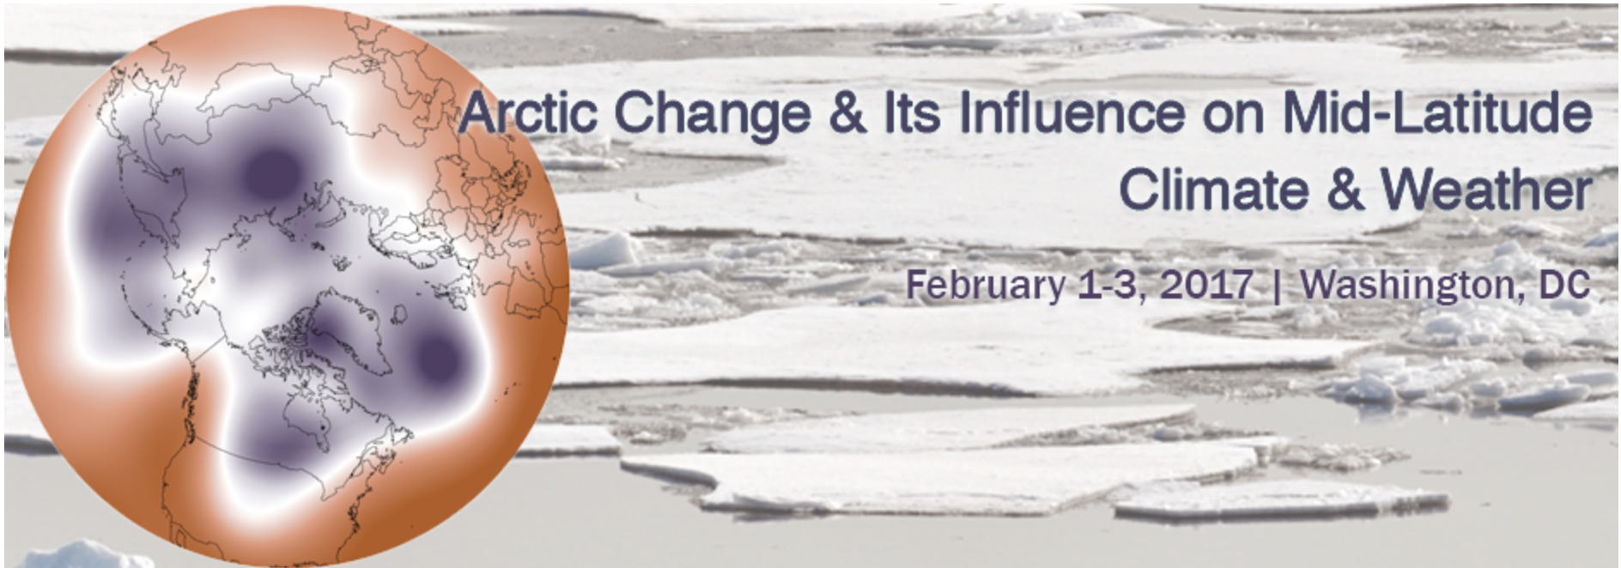
Strategy
Understanding of Arctic-midlatitude linkages
Coordinated multi-model approach
Employ coupled models
Additional testing with atmosphere-only models
Study linkages also from a short-term prediction perspective
Repeat with enhanced models
US CLIVAR Workshop

Slide 8
Strategy
Knowledge exchange
Focus on three key areas:
  User engagement
  Dissemination
  Training
Experienced partners taking the lead:
  Arctic Portal
  Barcelona Supercomputing Centre
  Association of Polar Early Career Scientists

Slide 9
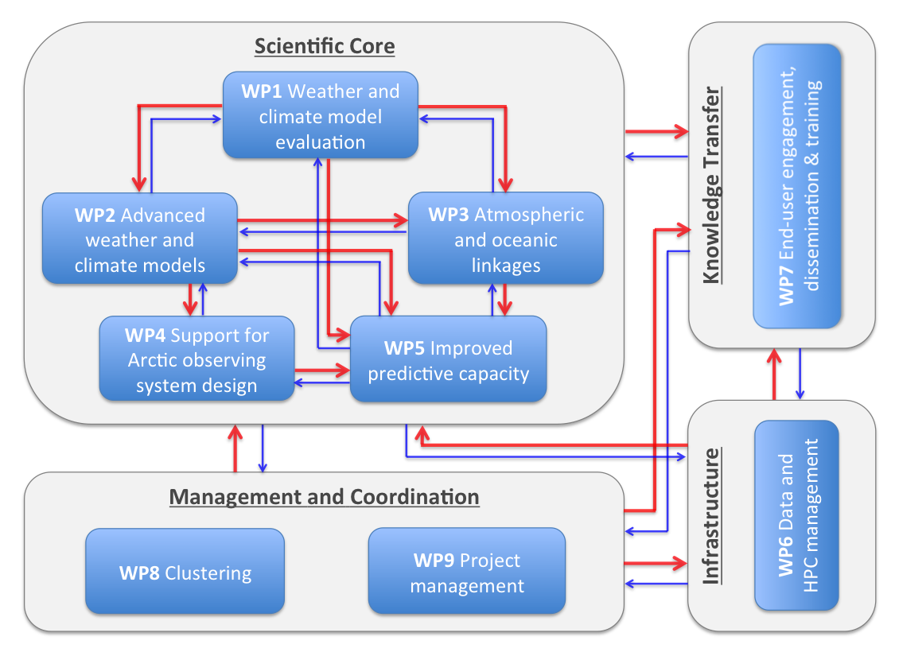
WP structure

Slide 10
WP1: Weather and climate model evaluation
Lead: Thomas Jung (AWI) and Len Shaffrey (Reading University)
Aim: Develop advanced metrics and diagnostics to observationally constrain weather and climate models
Selected key elements:
New process-based diagnostics and metrics (Arctic & linkages)
ESMValTool
Assessment in a data assimilation framework
Investigate error growth across time scales
Heat budget diagnostics
Exploit possible emergent constraints
Provide special YOPP data set

Slide 11
WP2: Enhanced Weather and climate models
Lead: Gunilla Svensson (Stockholm University) and Matthieu Chevallier (Meteo France)
Aim: Improve the representation of Arctic-specific processes in weather and climate prediction models
Selected key elements:
Targeted processes: Formation of clouds, boundary layer mixing in atmosphere and ocean, sea ice formation and melt, and surface energy exchanges
Employment of innovative coupled single column model framework
Development of next generation sea ice models
Explore the role of resolution using innovative approaches (e.g. unstructured meshes)
Thorough assessment of model enhancements

Slide 12
WP3: Atmospheric and oceanic linkages
Lead: Doug Smith (MetOffice) and Helge Drange (University of Bergen)
Aim: Advance our understanding of the mechanisms by which the mid-latitude weather and climate could respond to Arctic climate change
Selected key elements:
Suite of novel coordinated multi-model experiments
Employ coupled models
  Atmospheric and oceanic pathways
  Take into account effects of ocean-atmosphere coupling
Additional atmosphere-only models
  Explore relative role of ocean and atmosphere
  Explore the role of the background state on the response
  Sensitivity to details of the sea ice forcing
Prediction experiments (relaxation)
Determine the impact of model enhancements

Slide 13
WP4: Support for Arctic observing system design
Lead: Peter Bauer (ECMWF) and Thierry Fichefet (University Catholique de Louvain)
Aim: Guide the design of the future Arctic observing system in order to improve our capacity to reanalyse the Arctic climate system and enhance the predictive skill in the Arctic and beyond
Selected key elements:
Evaluation of exisiting datasets with a polar focus (reanalysis and data assimilation diagnostics)
Numerical observing system experiments (coupled and uncoupled)
Improve initial conditions (e.g., assimilation of sea ice thickness and snow)
Provide future recommendations

Slide 14
WP5: Improved predictive capacity
Lead: Virginie Guemas (BSC) and Trond Iversen (MetNo)
Aim: Deliver enhanced weather and climate forecast systems with improved predictive skill for the Arctic and beyond on daily to decadal time scales
Selected key elements:
Synthesize results from WP1-4
Compehensive assessment of existing prediction capacity
Identify sources of predictability
Develop empirical forecast systems as benchmark
Test enhanced forecasting systems (WP2 and WP4)
Make recommendations for operational implementation

Slide 15
WP8: Clustering
Lead: Thomas Jung (AWI) and Peter Bauer (ECMWF)
Aim: Ensure effective coordination with other related projects and initiatives
Selected key elements:
Coordination with related EU projects (Blue-Action, INTAROS, PRIMAVERA etc.)
Coordination with other international initiatives and projects (e.g. YOPP, SIPN and Belmont)
Develop clustering plan

Slide 16
Summary—APPLICATE will...
Advance predictive capacity in polar regions and beyond
  Develop models with enhanced representation of Arctic processes
  Contribute to developing the Arctic observing system
Enhance our understanding of Arctic-midlatitude linkages (also from a prediction perspective)
Bring different communities closer together
Work closely with users and stakeholders
Foster international collaboration
Contribute significantly to YOPP
www.applicate.eu

Slide 17
APPLICATE Advisory Board
Name | Area of expertise | Country
Cecilia Bitz | Model developent and sea ice prediction | USA
Gilbert Brunet | Weather and climate prediction | Canada
Clara Deser | Arctic-midlatitude linkages | USA
Veronika Eyring | Model evaluation and CMIP | Germany
Inger Hansen-Bauer | Climate and weather services | Norway
Jean-Noel Thepaut | Copernicus Climate Change Services | UK
Tero Vauraste | Stakeholder representative | Finland

Slide 18
External partners
...and many international collaborators

Slide 19
Stakeholders engaged in APPLIATE
...and many international collaborators

Slide 20
Selected activities
YOPP high-resolution analyses, forecasts and physical processes database (“YOPP virtual field campaign“)
Jung et al. (2016), BAMS

Slide 21
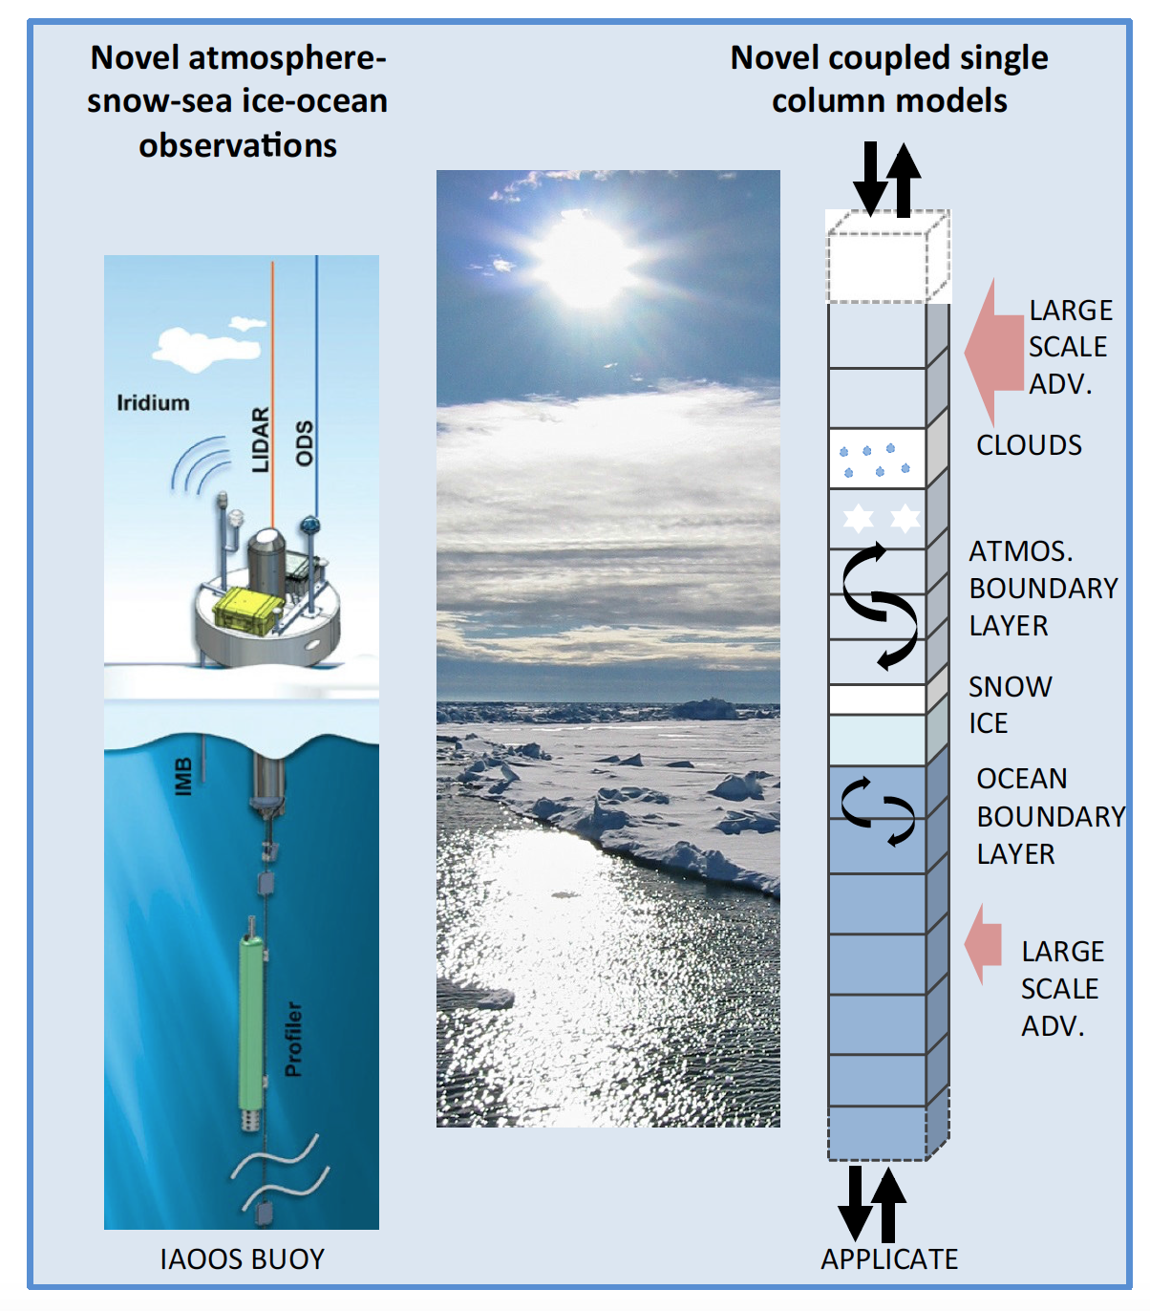
Selected activities
Coupled Single Column Modelling

Slide 22
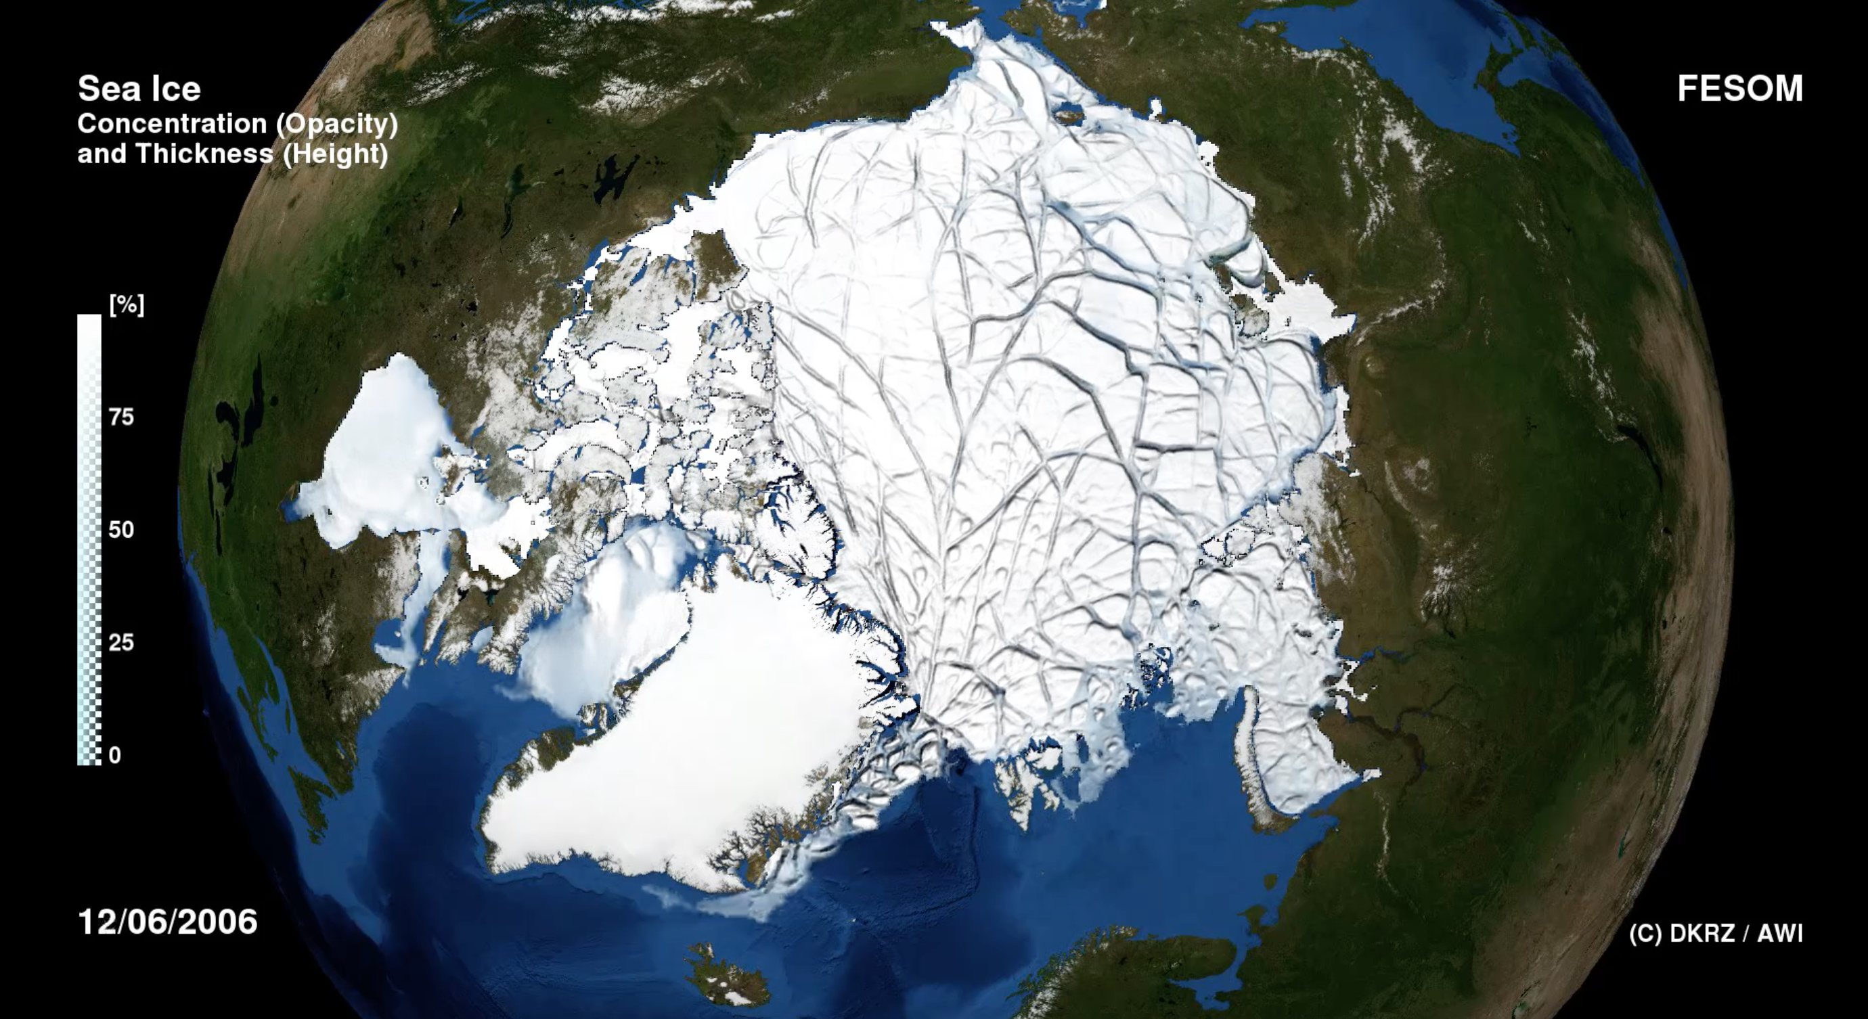
Selected activities
High-resolution sea ice-ocean modelling
Wang et al. (2016), GRL

Slide 23
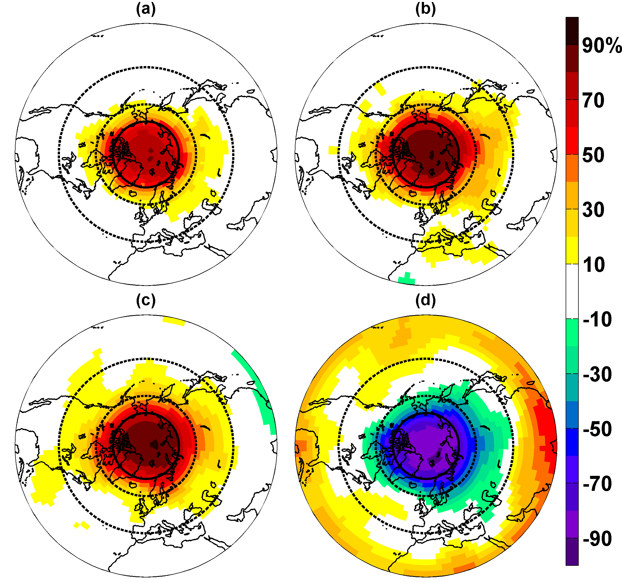
WP3—Selected activities
Coordinated relaxation experiments with S2S systems
Day 1-5
Day 6-10
Day 11-30
Jung et al. (2014), Geophys. Res. Lett.

Slide 24
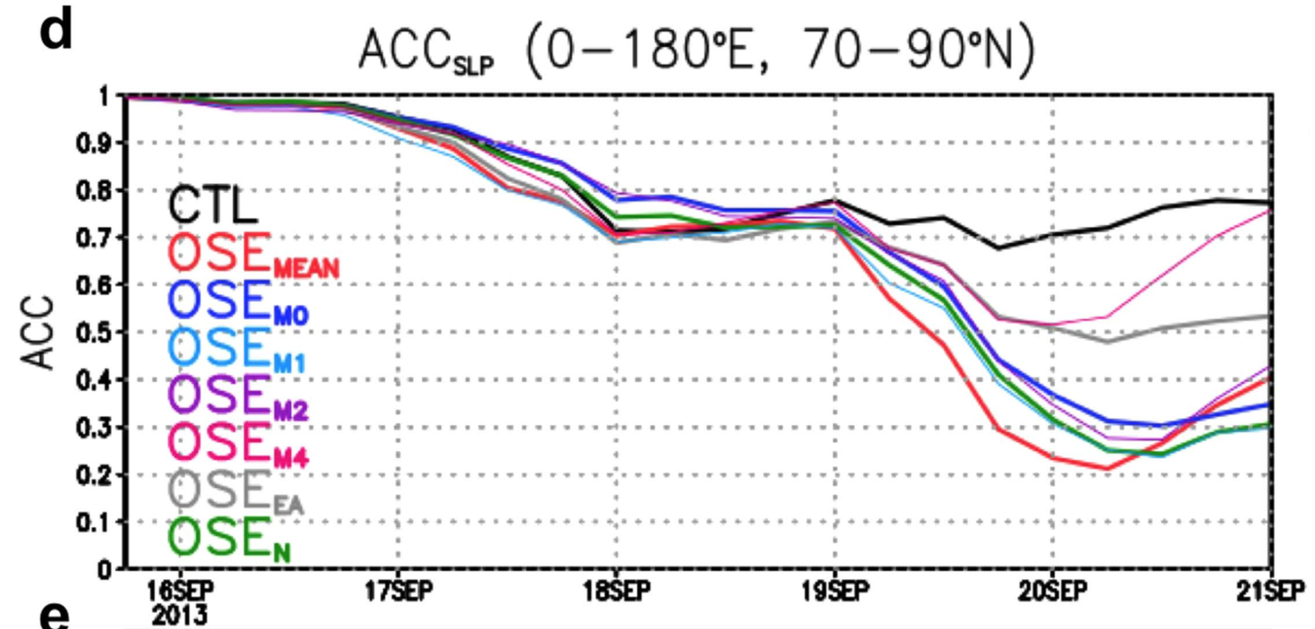
WP4—Selected activities
Data denial experiments
Source: Jun Inoue

Slide 25
Objectives
Observationally constrain models using advanced metrics and diagnostics
Develop enhanced weather and climate models
Determine the impact of Arctic climate change on midlatitudes through atmospheric and oceanic linkages
Contribute to the design of the future Arctic observing system
Enhance the capacity to predict Northern Hemisphere weather and climate
Develop APPLICATE in coordination with external partners
Transfer the knowledge generated through APPLICATE to stakeholders including training of early career scientists

Slide 26
Knowledge exchange
Focus on three key areas:
  User engagement
  Dissemination
  Training
Experienced partners taking the lead:
  Arctic Portal
  Barcelona Supercomputing Centre
  Association of Polar Early Career Scientists

Slide 27
User engagement
Work with a group of users and stakeholders
Workshops, meetings at professional conferences and interviews
Virtual consultations and surveys

Slide 28
Dissemination
APPLICATE website
Social media campaign
Visual identity material
Dissemination material
Press releases
Project reports
Papers in the peer-reviewed literature

Slide 29
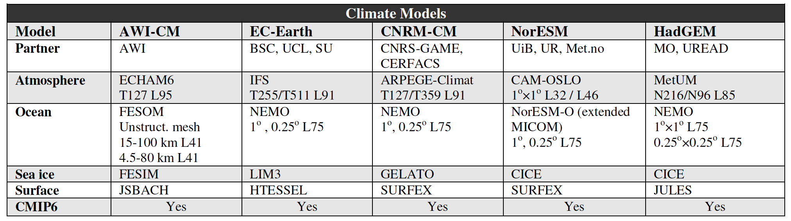
Participating climate models

Slide 30
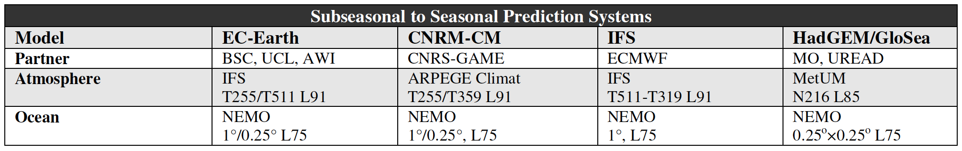
Participating S2S models

Slide 31
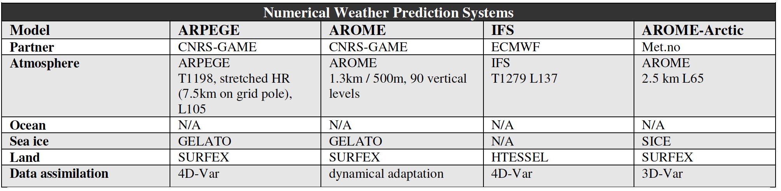
Participating NWP models

