Slide 1



Impact of SIC/SST for multi-decadal climatic trends;
Results from coordinated AGCM experiments
Fumiaki Ogawa^{1,2}, Yongqi Gao^{2,3}, Noel Keenlyside^{1,2}, Torben Koenigk⁴, Vladimir Semenov⁵, Lingling Suo^{2,3}, Shuting Yang⁶, Tao Wang⁷
¹Geophysical Institute, University of Bergen, Norway. ²Bjerknes Centre for Climate Research, Norway. ³Nansen Environmental and Remote Sensing research Center, Norway. ⁴Swedish Meteorological and Hydrological Institute, Sweden. ⁵Helmholtz Centre for Ocean Research Kiel, Germany. ⁶Danish Meteorological Institute, Denmark. ⁷Chinese Academy of Sciences, Institute of Atmospheric Physics, China.

Slide 2
EXP1 – daily SIC & SST as observed
NOAA daily data (1982-2013)
Six AGCMs
20 member ensembles for each model
EXP2 – SIC is same but SST is daily climatology

Slide 3
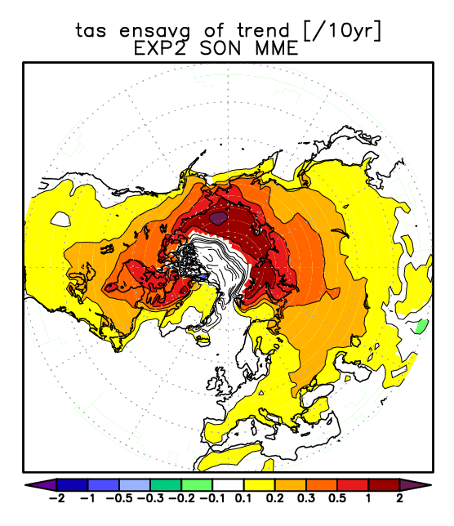
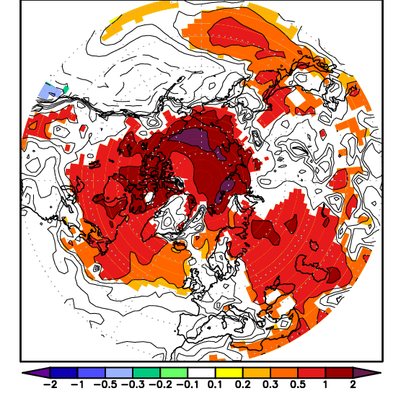
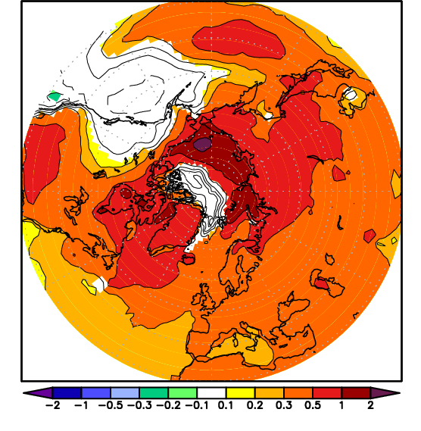
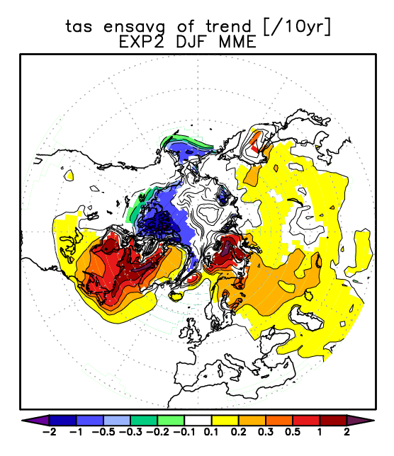
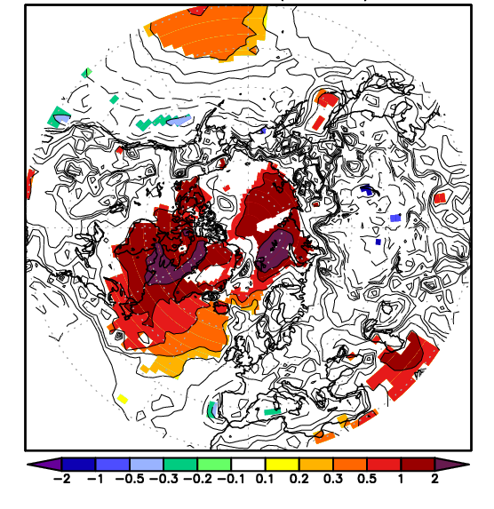
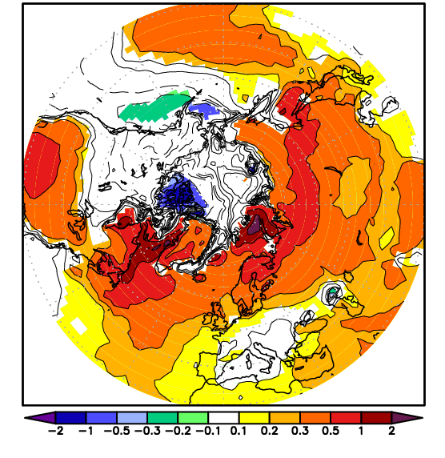
Simulated 2m Temperature trend [K/10yr]
ERA-Int
1982-2013
EXP1(MME)
1982-2013
EXP2 (MME)
1982-2013
PAC
Similar
SON
EURASIA
G
ATL
Shaded for
95% confidence.
Consistent among AGCMs
-Polar warming pattern is due to SIC (EXP1–EXP2=SST impact)
disagrees among reanalysis [Lindsay et al. 2015])
-Warming is local & similar (
DJF
W
W
W
W
W
W

Slide 4
On the wintertime warming in GREENLAND (T2m)
ERA-Int
1982-2013
EXP1(MME)
1982-2013
EXP2 (MME)
1982-2013
•GREENLAND warming is due to SIC.
•Tropical variability of SST (Ding et al. 2014) is not required.
DJF

Slide 5
On the wintertime warming in north-east U.S (T2m)
ERA-Int
1982-2013
EXP1(MME)
1982-2013
EXP2 (MME)
1982-2013
•Warming in north-east U.S. is simulated as observed: SIC impact
DJF

Slide 6
On the wintertime cooling trend in Siberia (T2m)
ERA-Int
1982-2013
EXP1(MME)
1982-2013
EXP2 (MME)
1982-2013
•Siberian cooling is not simulated in EXP1/2

Slide 7
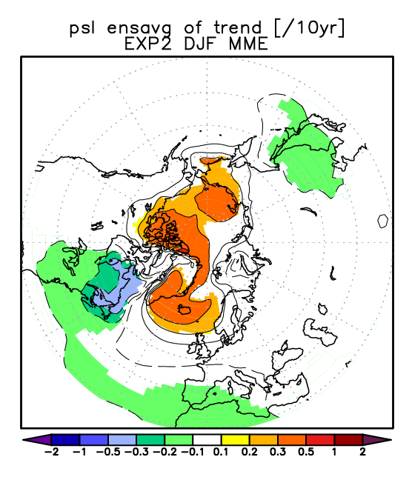
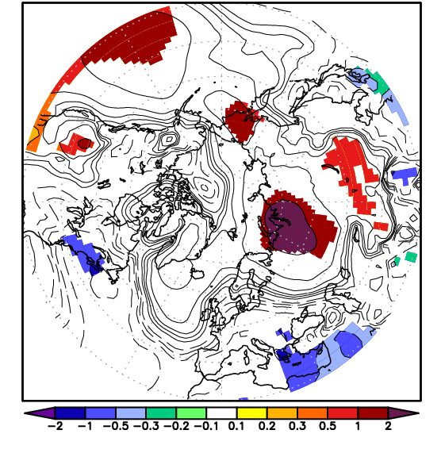
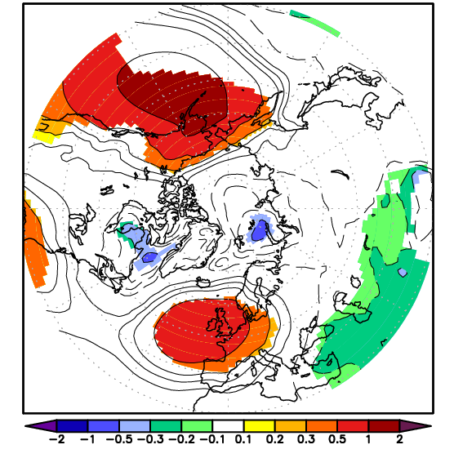
On the wintertime cooling trend in Siberia (T2m)
ERA-Int
1982-2013
EXP1(MME)
1982-2013
EXP2 (MME)
1982-2013
Absence of SLP trend;
siberian cooling disappears.
(McCusker et al. 2016)
DJF
SLP
• Observed Siberian cooling is nothing to do with SST/SIC change.
DJF

Slide 8
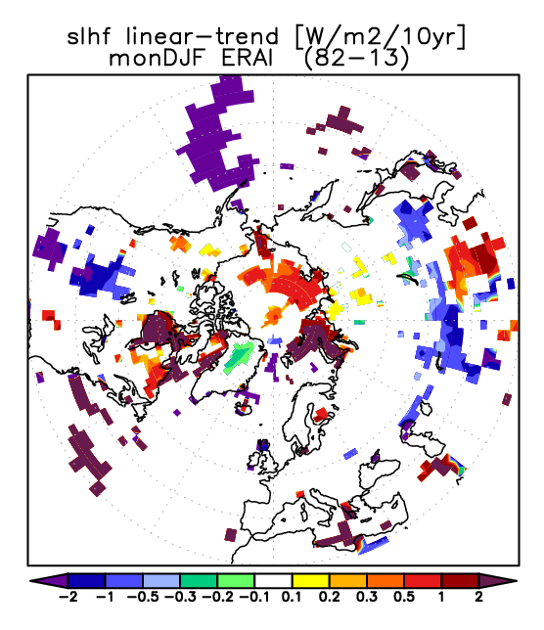
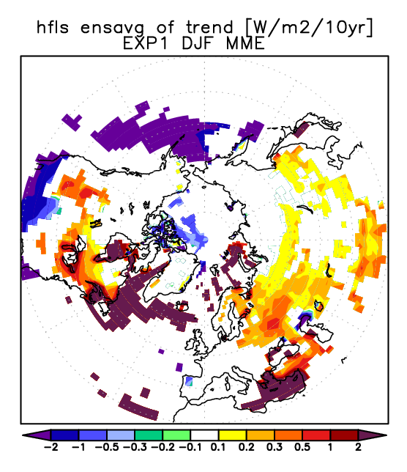
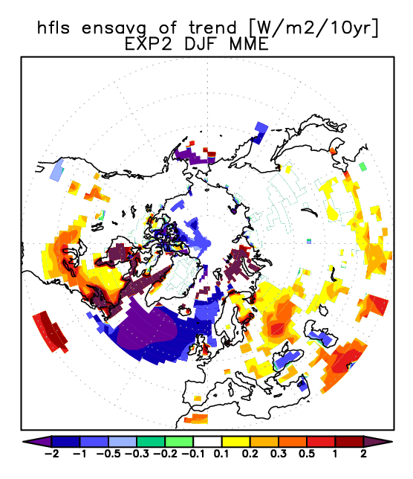
Correspondence to upward LHF trends [W/m2/10yr]
ERA-Int
1982-2013
EXP1(MME)
1982-2013
EXP2 (MME)
1982-2013
DJF
T2m
•SIC impacts B-K and north-eastern U.S. warmings through LHF.
DJF
LHF
BK
BK
BK
•Note: GREENLAND warming is not due to LHF.

Slide 9
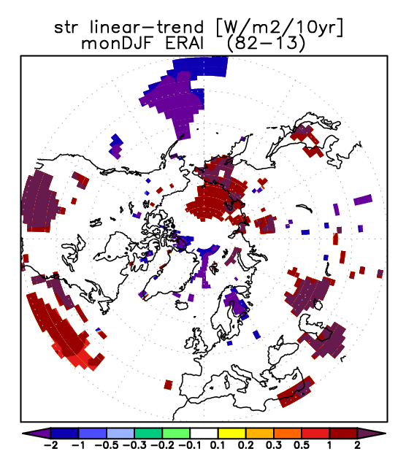
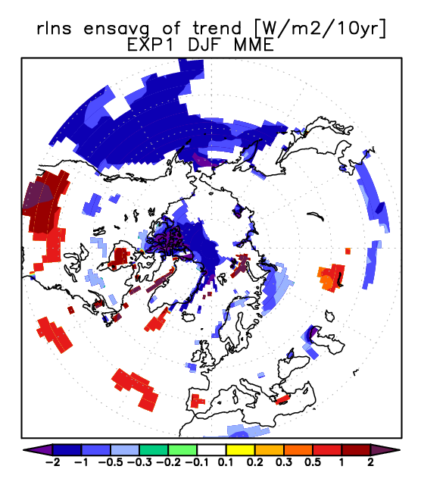
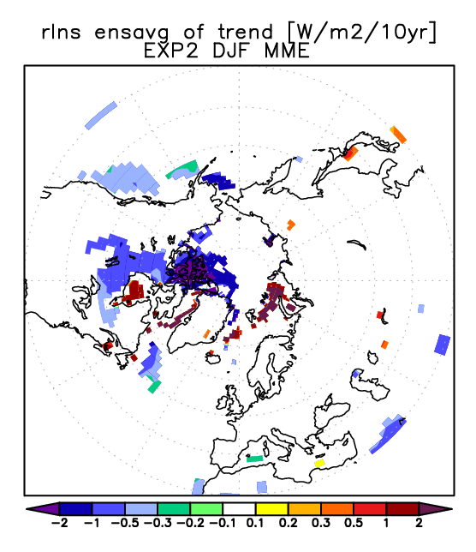
Trend of upward net long-wave radiation at the surface
ERA-Int
1982-2013
EXP1(MME)
1982-2013
EXP2 (MME)
1982-2013
DJF
T2m
•SIC impacts warming in B-K regions also through LR.
DJF
LR
BK
BK
BK
Main cause of unrealistic cooling is mainly by jump of NOAA-SIC in the region (2005)

Slide 10
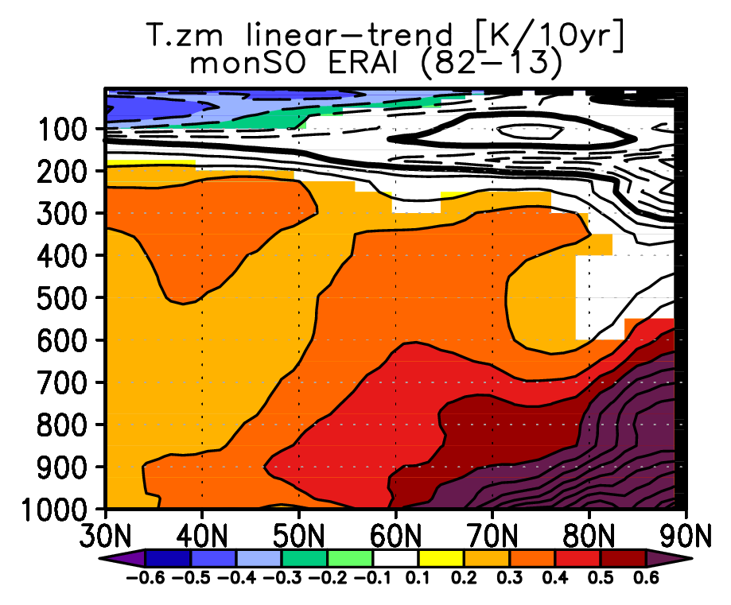
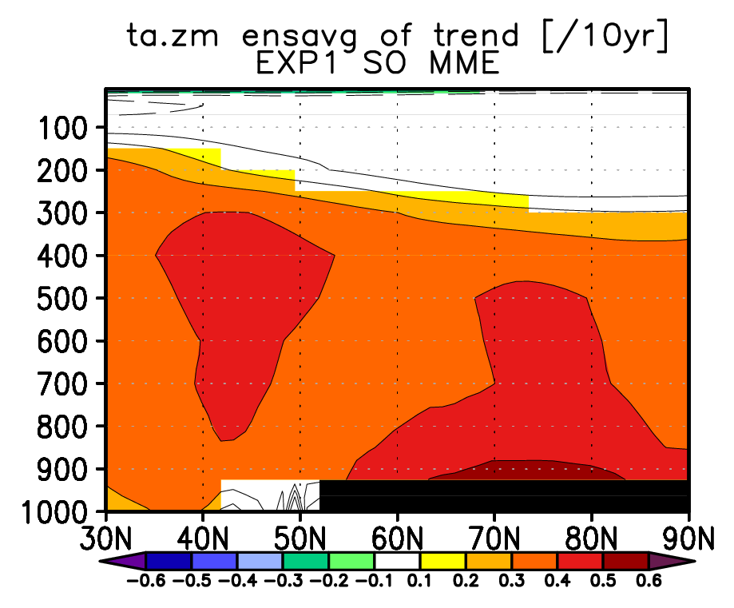
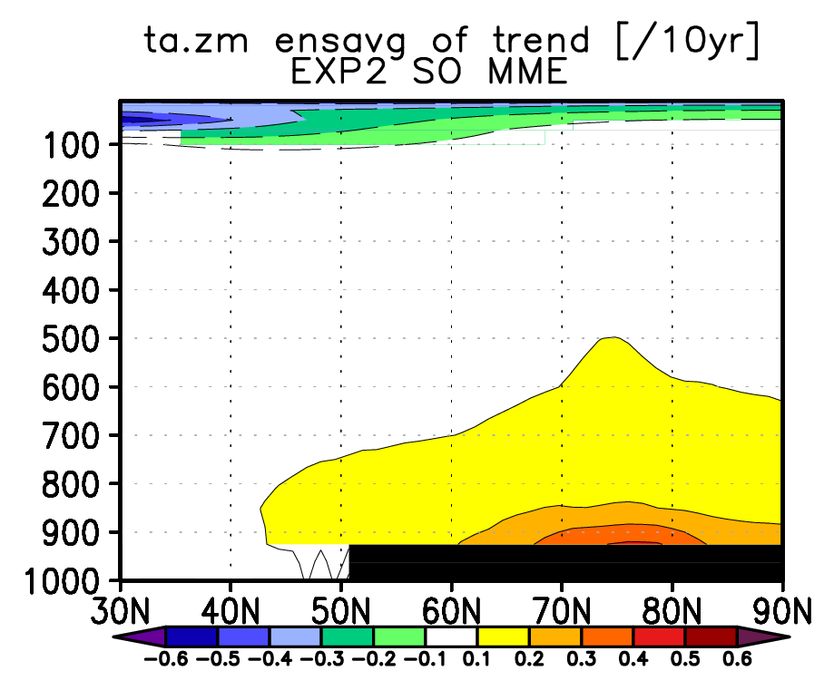
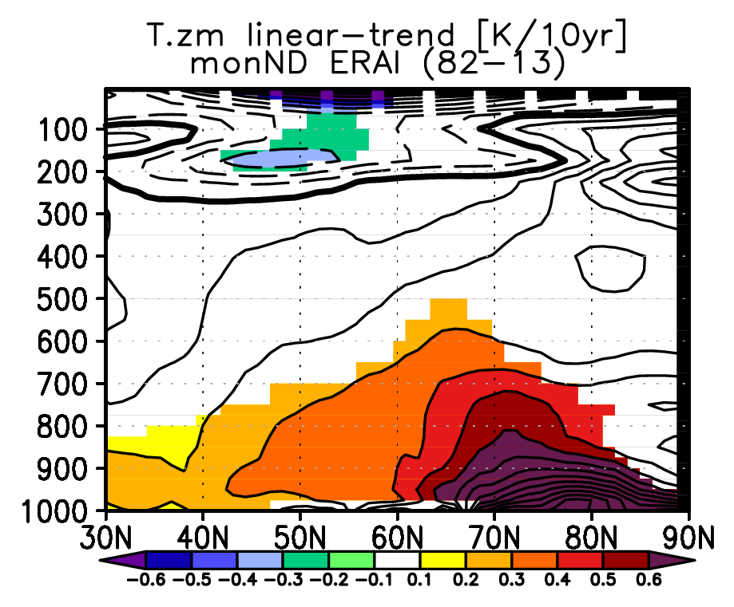
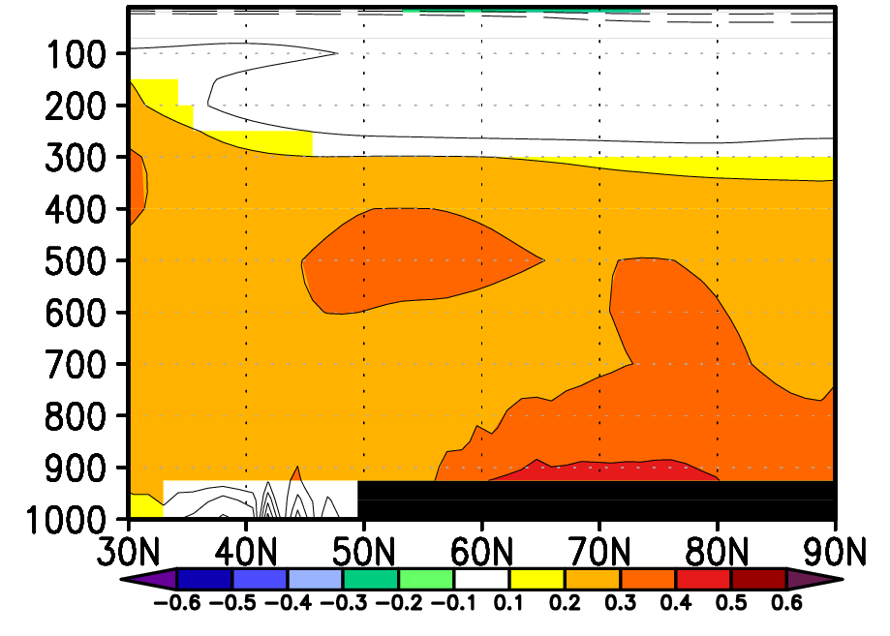
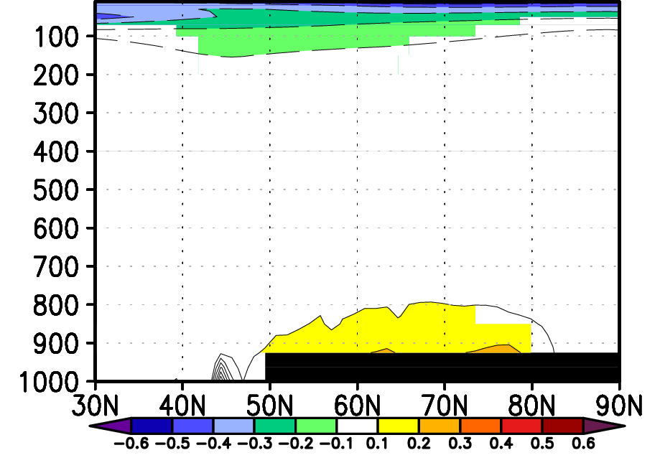
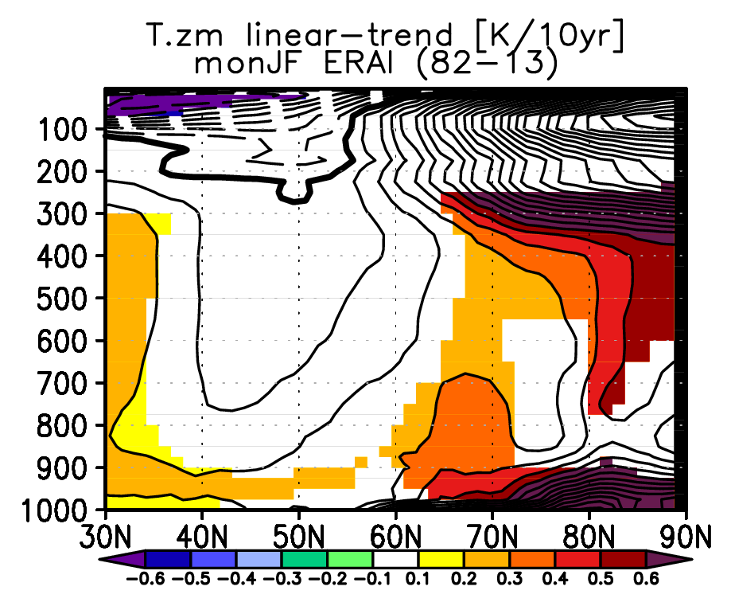
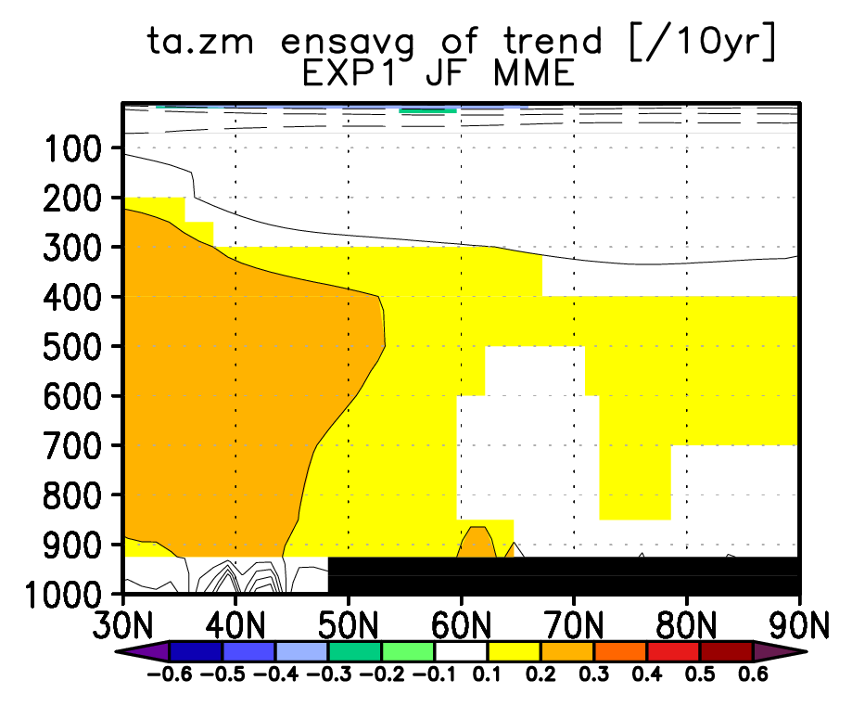
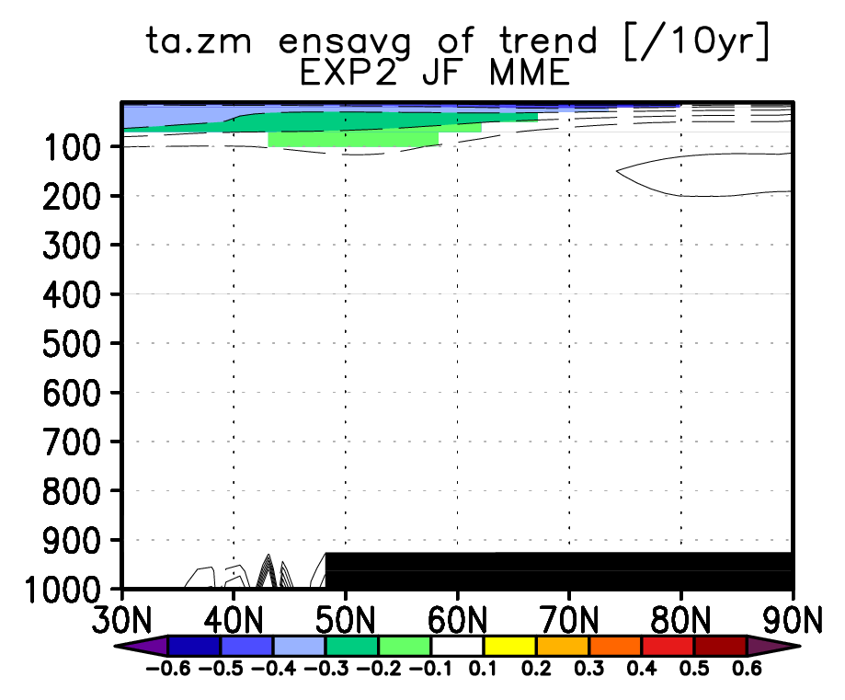
Zonal mean Temperature trends
ERA-Int
1982-2013
EXP1(MME)
1982-2013
EXP2 (MME)
1982-2013
SIC impact is limited in
lower troposphere
(Screen et al. 2012)
SO
“Arctic amplification (AA)”
•Simulated warming is centered in SIC changing latitudes.
ND
ERA-I warming lat.
almost coincides to EXP1/2.
Observed surface warming in JF is local: N-E.U.S., B.K., GREENLAND: reproduced in EXP1/2.
AA is less clear above even in reanalysis. Model shows little contribution of SST/SIC.
JF

Slide 11
Summary: Impact of SIC/SIC for the observed trends
GREENICE COORDINATED experiments have made implications for previous findings:
Arctic Amplification:
Autumn and early winter:
•AA is influenced by SIC, but limited near the surface.
Impact of SST is dominant above. (supporting Screen et al. 2012)
•SIC seems relevant for spatial distribution of land surface temperature trend.
Late winter: AA itself become less obvious.
-Surface AA is rather localized: still explained by SIC impact
: Tropical SST change (Ding et al. 2014) seems not required.
-Warming above is not clear: little contribution by SST/SIC
Thermodynamics for the warming trends is need to be addressed more in detail...
Siberian cooling in winter:
•Seems like internal variablity of atmosphere, nothing to do with SST/SIC.
- supporting (McCusker et al. 2016)
Notes:
What is mechanism to increase LHF(SHF). It is increased flux of moisture. Large scale circulation?
Down ward increase : watervapor increase u contribution or q contribution?
SIC somehow causes circulation, then in turn causes surface heat fluxes.
If the advenction warms entire lower column through poleward heat transport, then the net upward flux will be nearly 0. does daily data have any lag? ← if the reviewer attack us
But will not matter for interannual trend.
Atmospheric feedback is SLP trend to make it warmer.
Still difficult to understand Z700. but how about other reanalysis?

